Slide 1
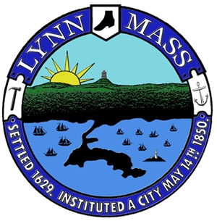
Life Science Development Tour
September 30, 2022
WELCOME To Lynn!!

Slide 2
Lynn is ready for Life Sciences
Lynn is one of two municipalities that are members of MassBio
Lynn has reached Platinum Status
Lynn has passed unanimously a Life Science Ordinance

Slide 3
Development Community has found Lynn…
This Year Alone…
Exchange Street- (Ongoing) $80,000,000
144 Market Street- (Ongoing) $90,000,000
472 Essex St- Approved $3,000,000
Neptune Blvd- Approved $3,000,000
Blossom Street- Approved $25,000,000
Kings Beach Towers- Approved $30,000,000
South Harbor- (Ongoing)
Post Road- Approved $100,000,000 (Phase I)
Franco American site- (Ongoing)
26 Farrar St- Approved $8,000,000
Cottage St- Approved $8,000,000
87 Oxford Street- Approved $11,000,000
811 Lynnway- Approved $90,000,000

Slide 4

Developer Meets with City’s Entire Team
Development Team
Mayor Nicholson
EDIC Director
ISD Director
DPW Commissioner
Lynn Housing Director
Community Development Director
City Planner
Ward Councilor

Slide 5
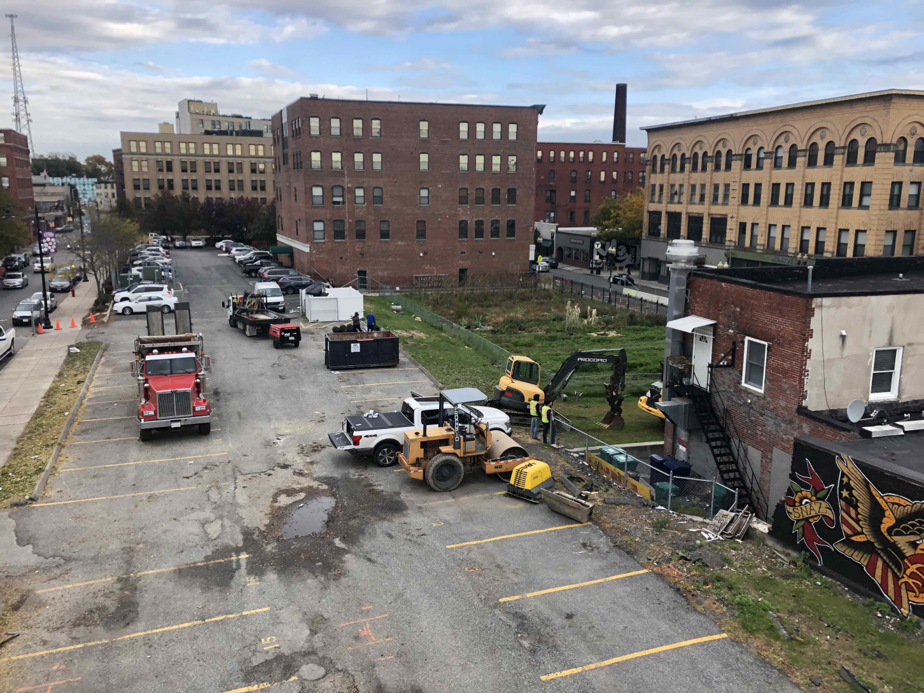
Munroe Street….Before

Slide 6
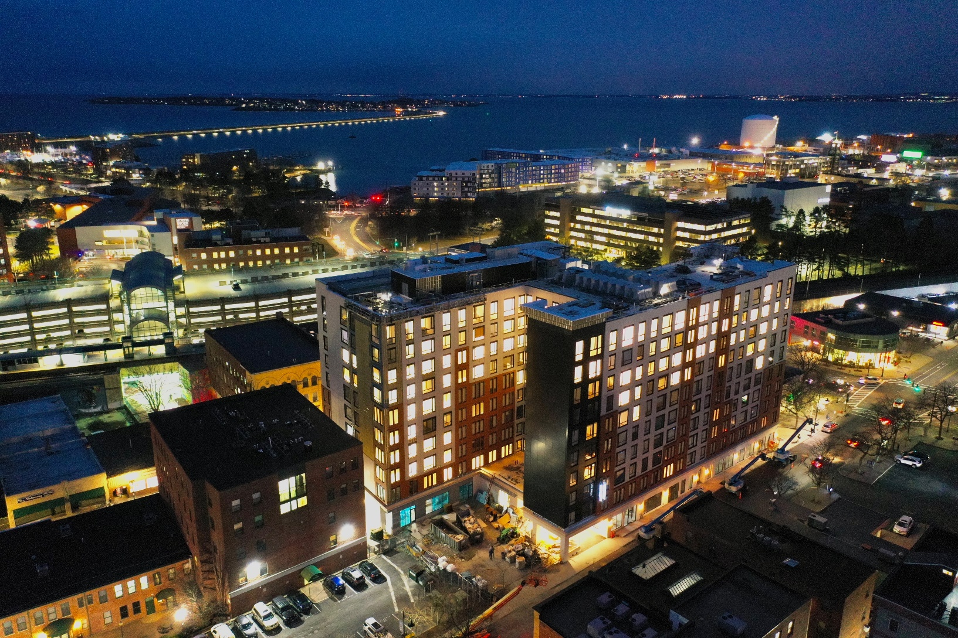
Munroe Street…today

Slide 7
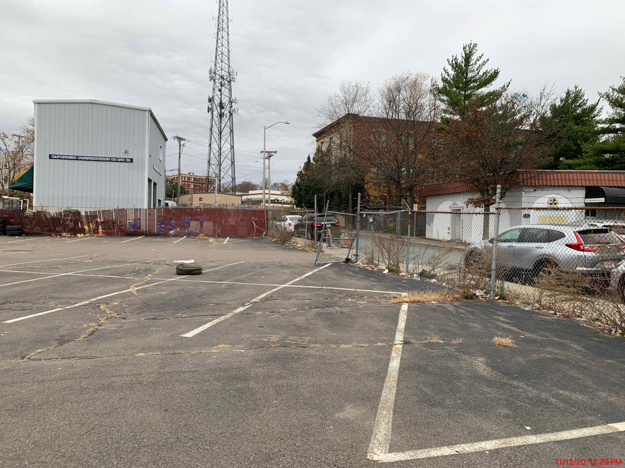
Baldwin Street…Before

Slide 8
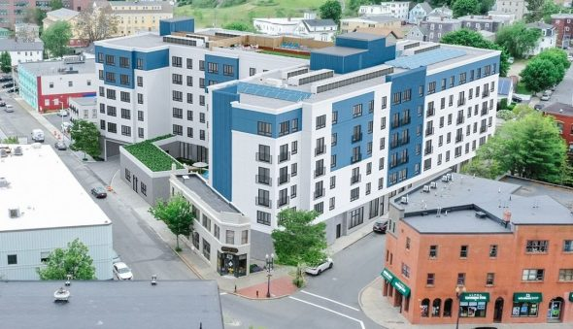
Baldwin Street……Today
The six-story Baldwin Street Building in Lynn, MA is 147,500 SF of wood frame, steel podium new construction with 146 units of market rate apartments on floors two through six.
The ground floor will include 3,500 SF of retail and restaurant space, utility storage, amenity space, and at-grade parking for 38 vehicles.

Slide 9
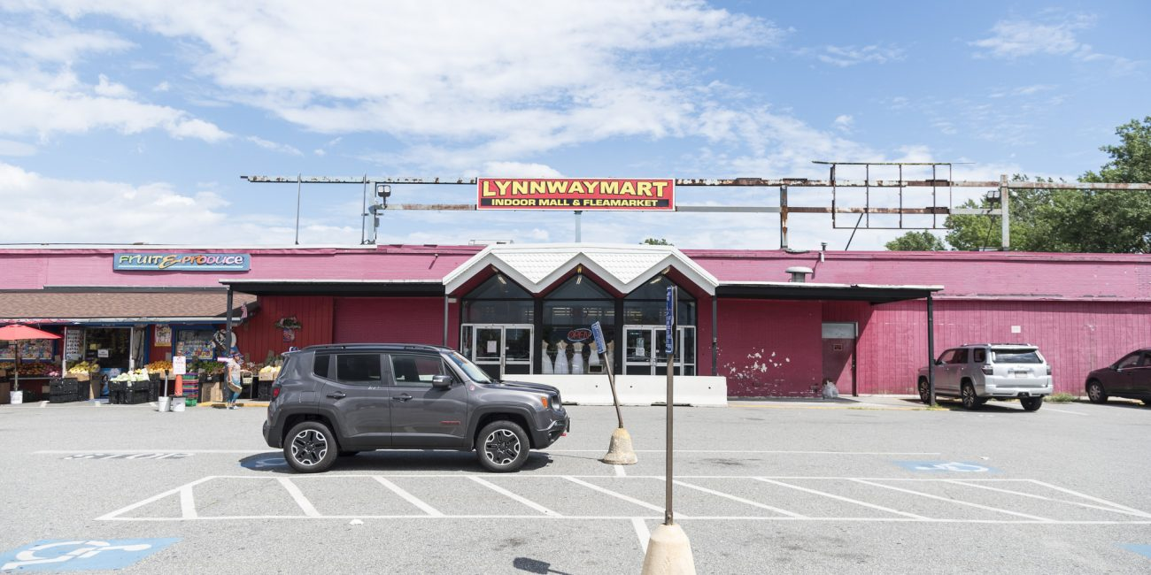
Lynnway Mart……Before
Lynnway Mart yesterday
Being replaced with a $450 million-dollar Two-Phase mixed-use development

Slide 10
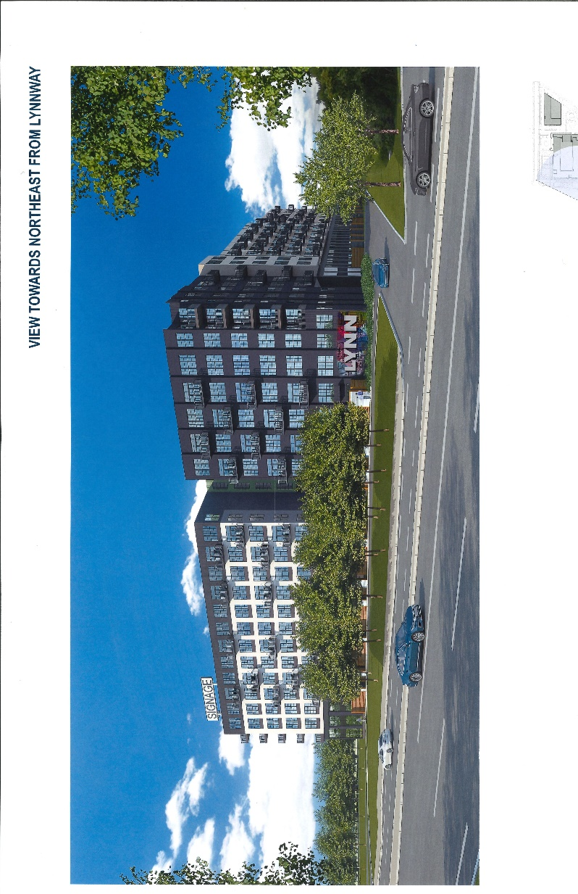
Lynnway Mart…..After
Lynnway Mart has been demolished and Phase I has begung and will include large open spaces that will be utilized by the public

Slide 11
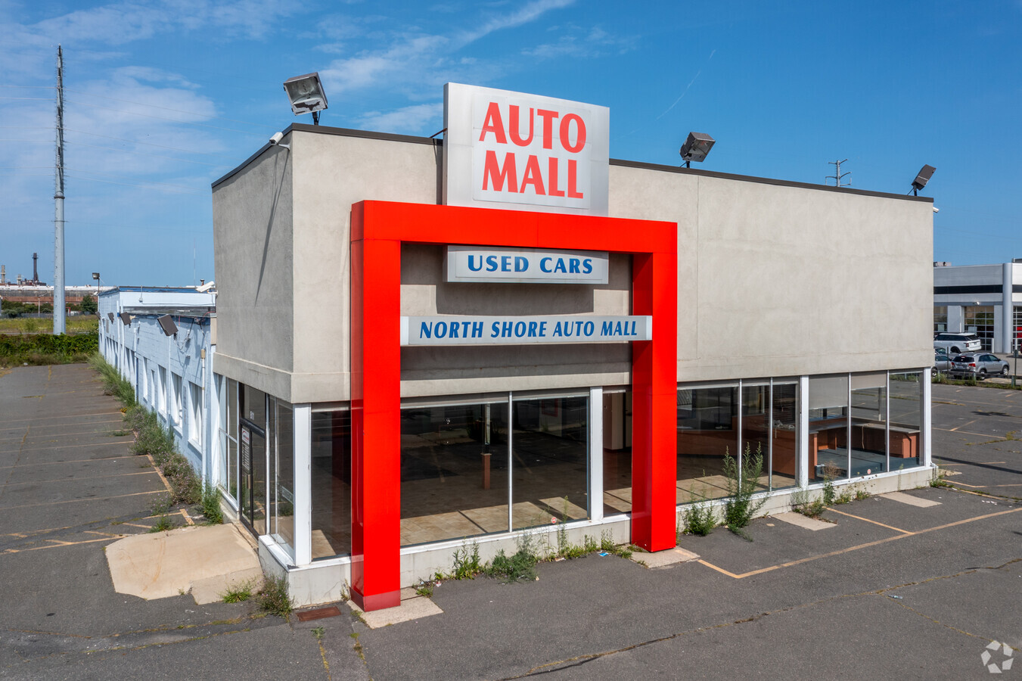
811 Lynnway….Today

Slide 12
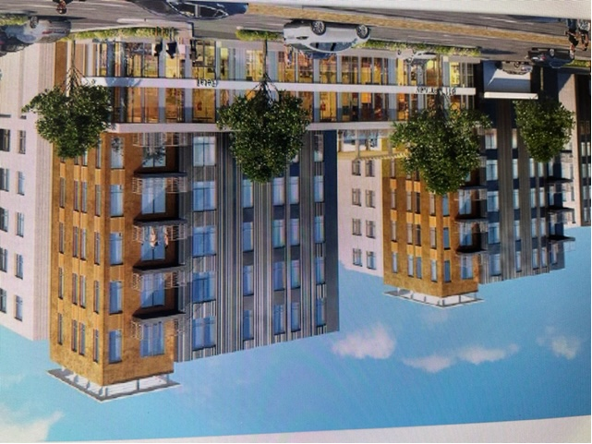
811 Lynnway Tomorrow

Slide 13
811 Lynnway….Tomorrow
Used auto dealer is being replaced with $100 million-dollar mixed use development
Developer is donating $3,000,000 to an affordable trust fund
This is the first donation to the affordable trust fund in Lynn’s history

Slide 14
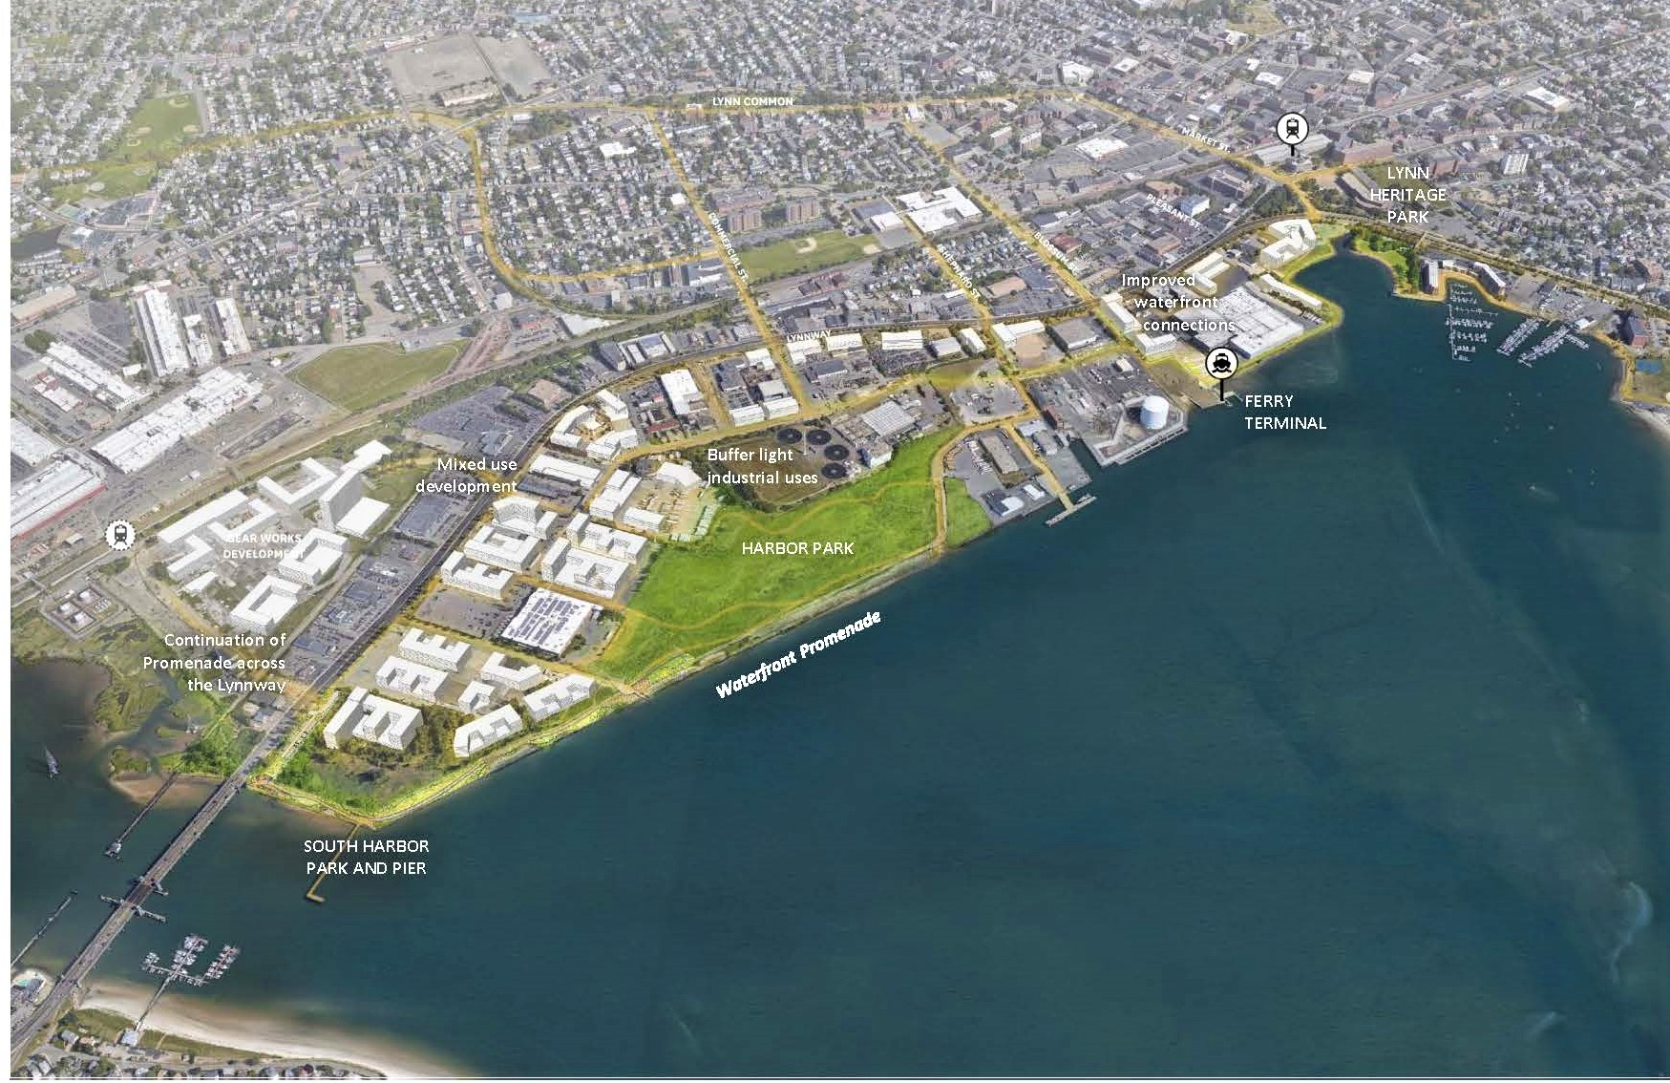
Waterfront
Harbor Park project

Slide 15
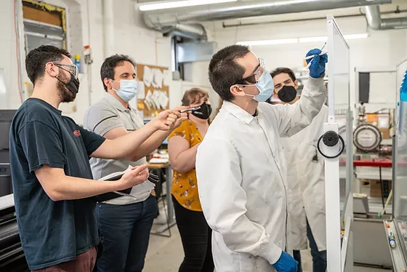
Soliyarn is coming to Lynn!
Soliyarn specializes in the development & manufacturing of smart textiles by utilizing conductive, waterproof coating

Slide 16
Soliyarn
Mayor Nicholson and City Council approved a tax incentive
Over five years 105 jobs will be created
Average salary of those jobs will be $87,000/year
Soliyarn received a State grant for $1,000,000
Soliyarn received a large state tax credit. Thank You MOBD!
They have just landed a large contract with Department of Defense

Slide 17
Thank you!
And one last thing….
Let's watch a quick video which will show you the real Lynn and all that it offers!

